Slide 1
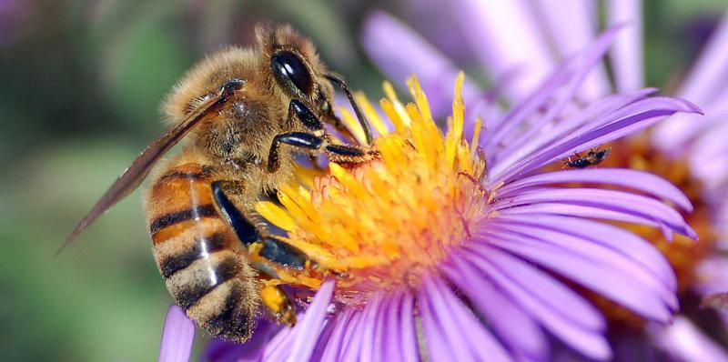
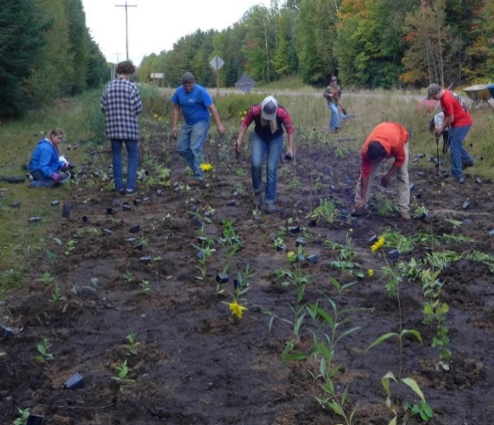
Building a
Pollinator Community
Pollinator Friendly Farming
August 29th , 2017
Baerbel Ehrig- Pollinator Coordinator
John Stauner - Cranberry Grower
Paula Larson – Monarch butterfly breeder
Todd Wilfer – Beekeeper and science teacher
Peggy Winter- USDA-NRCS
by John Severns
By Jennifer Hopwood, Xerces Society
By John Anderson, Hedgerow Farms, Inc

Slide 2
Background
Building a Pollinator Community

Slide 3
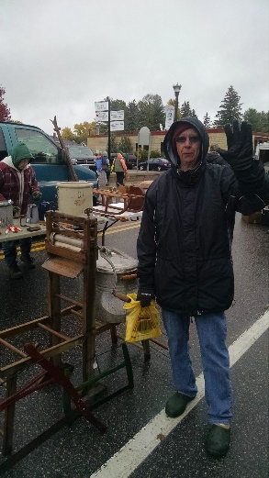
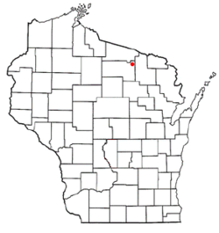

Vision of former Oneida County Conservationist, Jean Hansen
          Partnership between Three Lakes & Oneida County
Lumberjack Resource Conservation & Development Council (RC&D) Grant
  $9,234

Slide 4
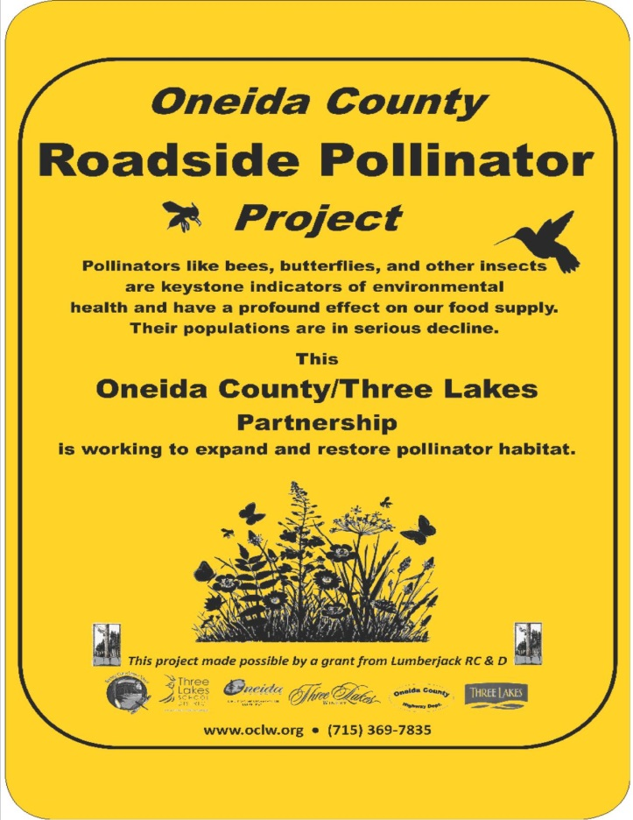

Slide 5
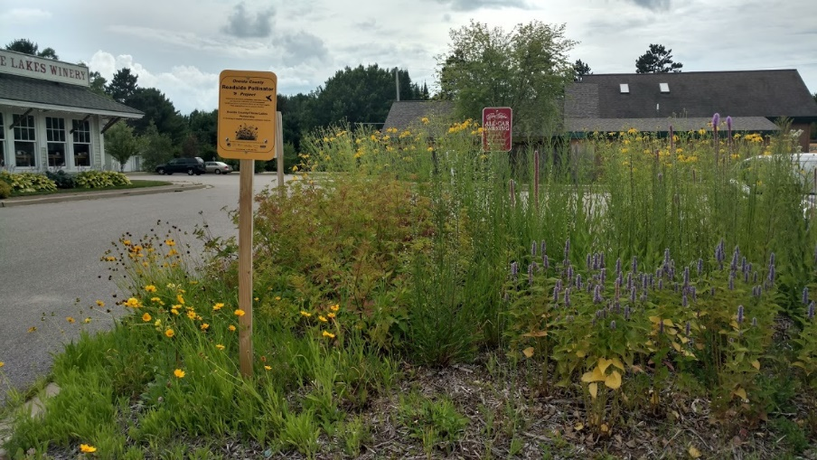
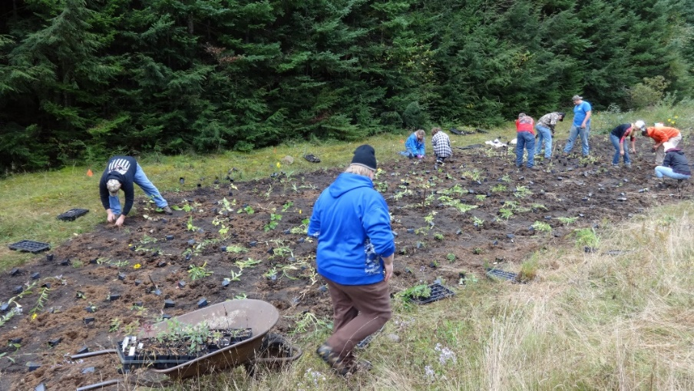
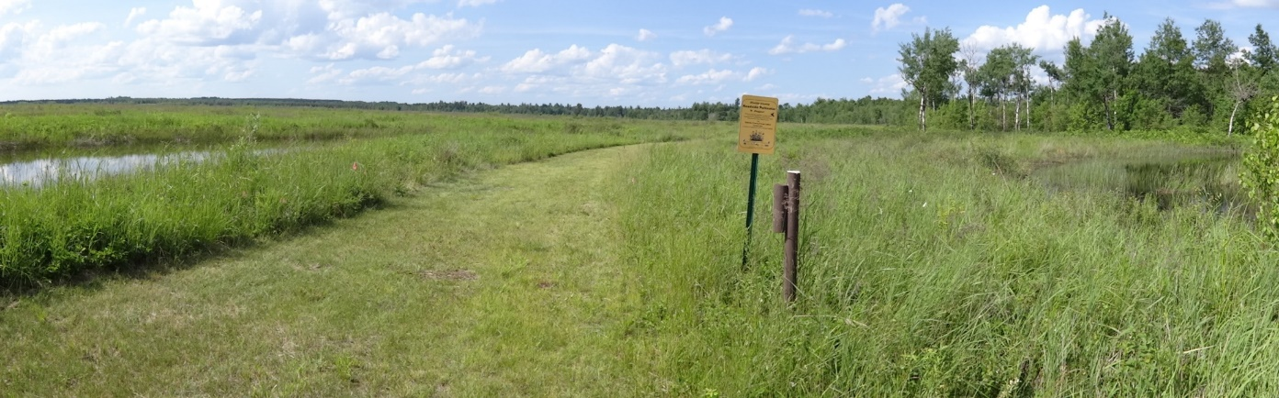
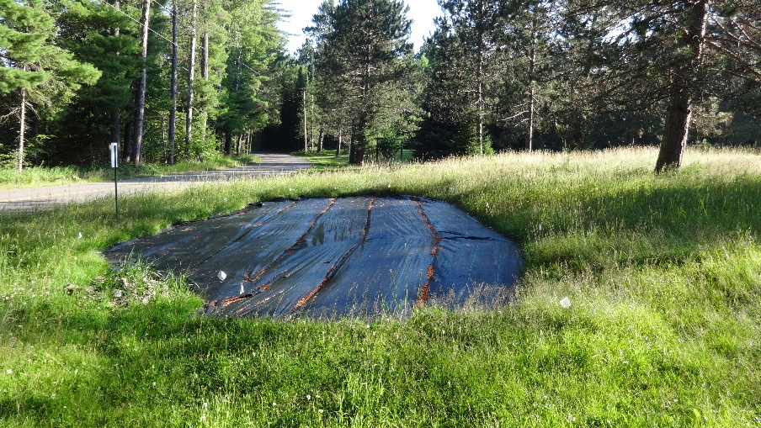
2016 sites Three Lakes, WI

Slide 6
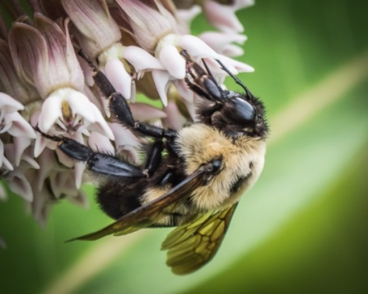
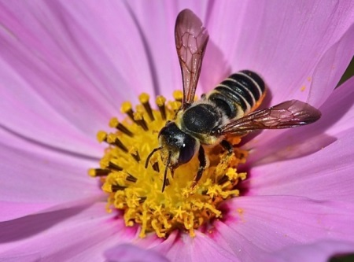
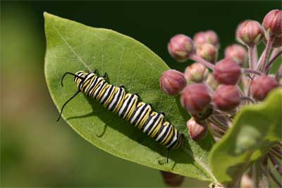
Experts Say:
  Improving native pollinator habitat naturally leads to an increase in native pollinators.
  Due to restored native habitat, plots show an increase in native pollinator activity.
     Our plots show increased native pollinator activity!
  The presence of host plants is an important driver for butterfly colonization.
     Our plots host caterpillars of the Monarch Butterfly!

Slide 7
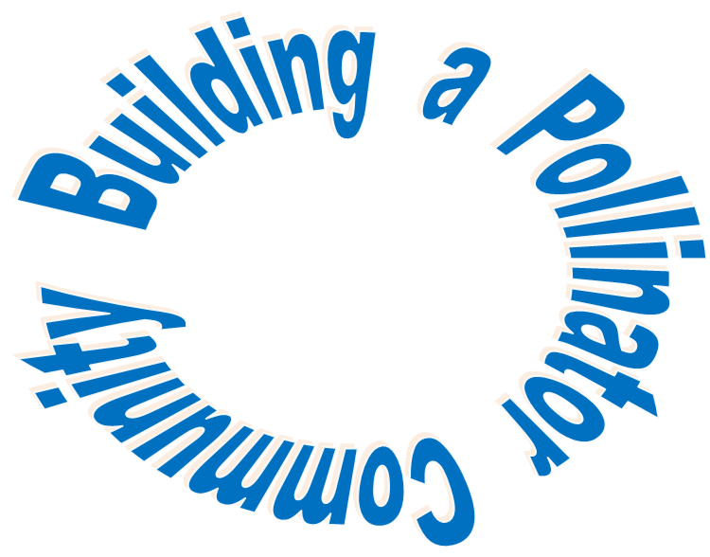
Motivation

Slide 8
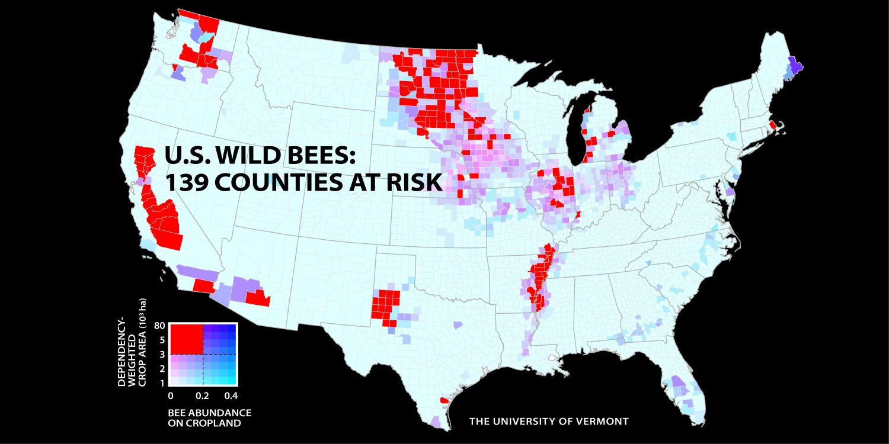
Over 50% decline in managed honey bee hives since 1950
Over 50% of native NA bee species are decreasing
Meanwhile crop pollination demand is rising

Slide 9
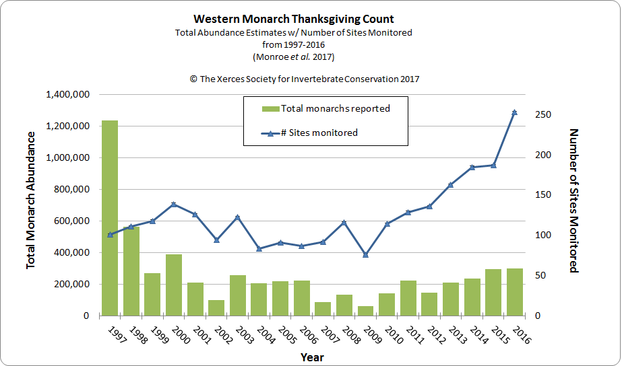

Slide 10
Reasons for the Serious
Decline of Pollinators:
Habitat loss
Disease
Climate change
By John Anderson, Hedgerow farms INC.

Slide 11
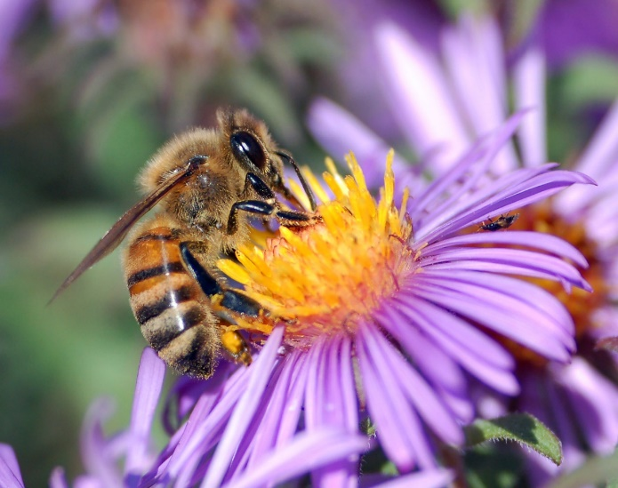
How do we build a Pollinator Community
Provide educational outreach
Increase pollinator habitat
Connecting communities

Slide 12
Educational Outreach
Building a Pollinator Community

Slide 13
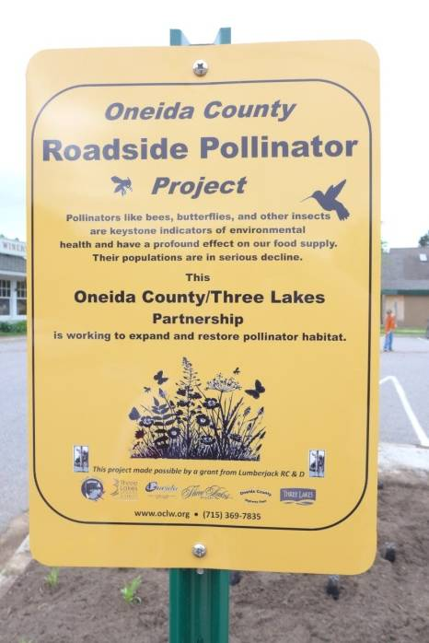
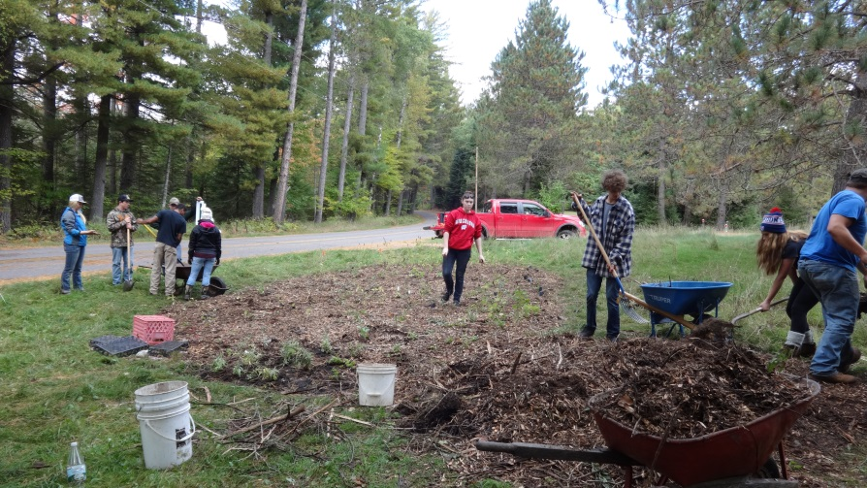
Educational sign at each site
Public presentations
Workshops/Field Visit
General public and local high school involvement in planting and maintaining habitat
Involving media

Slide 14
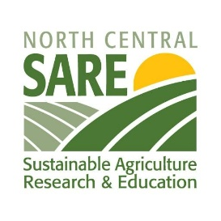
SARE (Sustainable Agriculture Research & Education) Grant
Engage educators, farmers, and citizens on pollinator friendly farming
Provide education and tools to
create and/or protect pollinator habitat

Slide 15
Habitat
Building a Pollinator Community

Slide 16
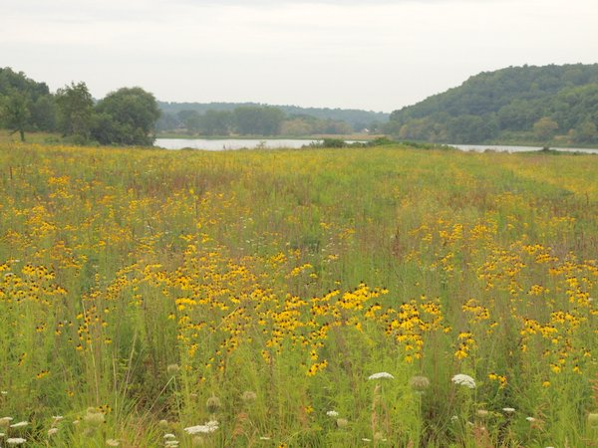
Native wildflowers
  Strengthen habitat for native pollinators
  Have recreational and aesthetic value
  Strengthen native ecosystem
By Lorraine Seymour

Slide 17
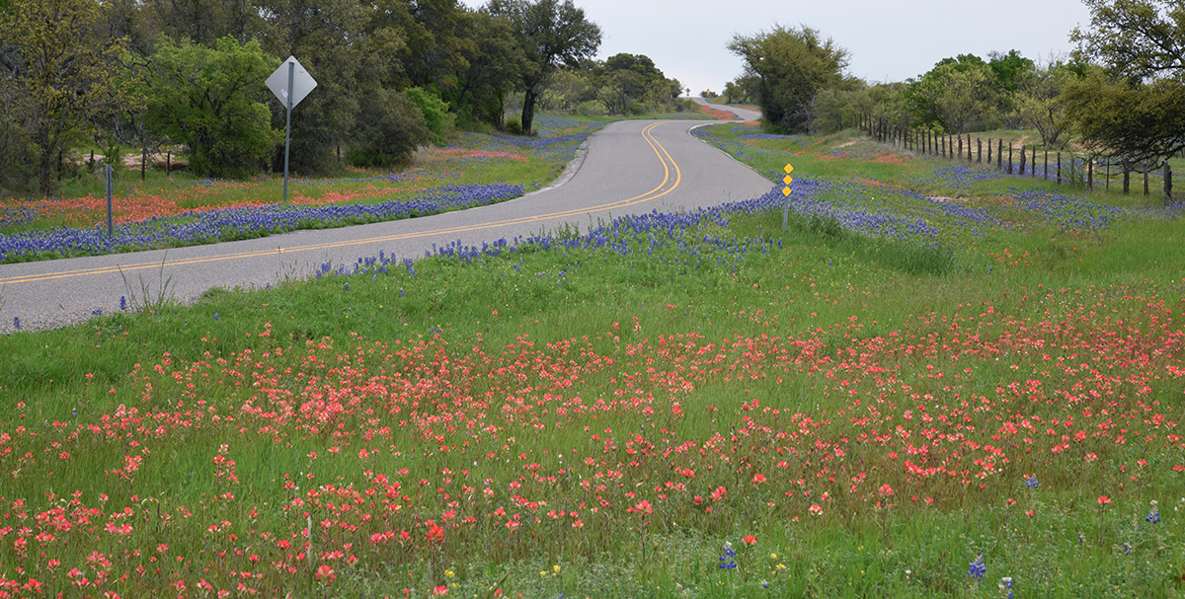
Why Roadsides?
  Public exposure
  Corridors for seed dispersal
  Beautification

Slide 18
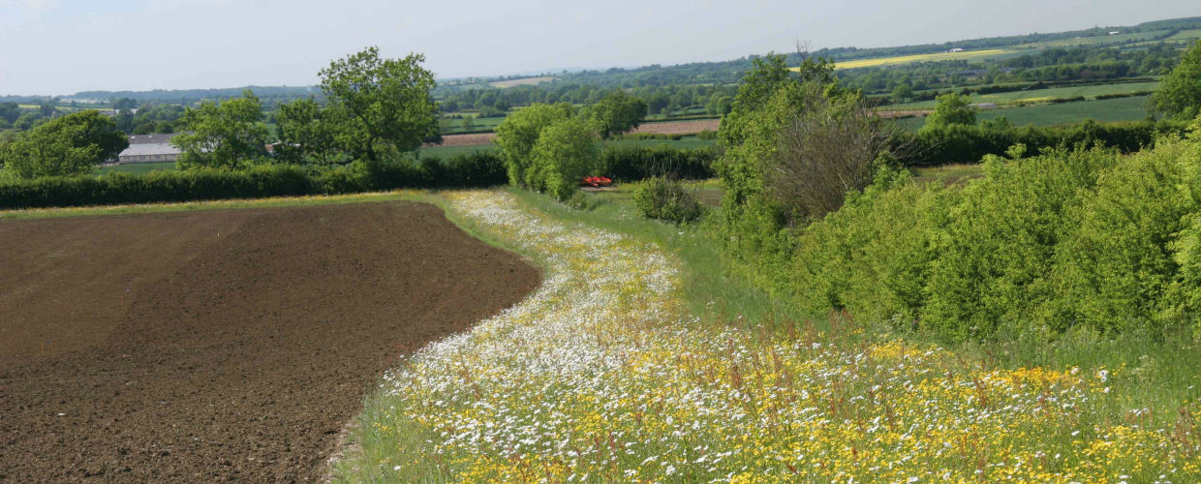
Why Farmland?
  Applied chemicals have strong effect on pollinators
  ~ 30 % of crops worldwide depending on insect pollination
  Crops increase up to 300% with presence of native pollinators
  Pollinator corridors breaking up the monoculture crops

Slide 19
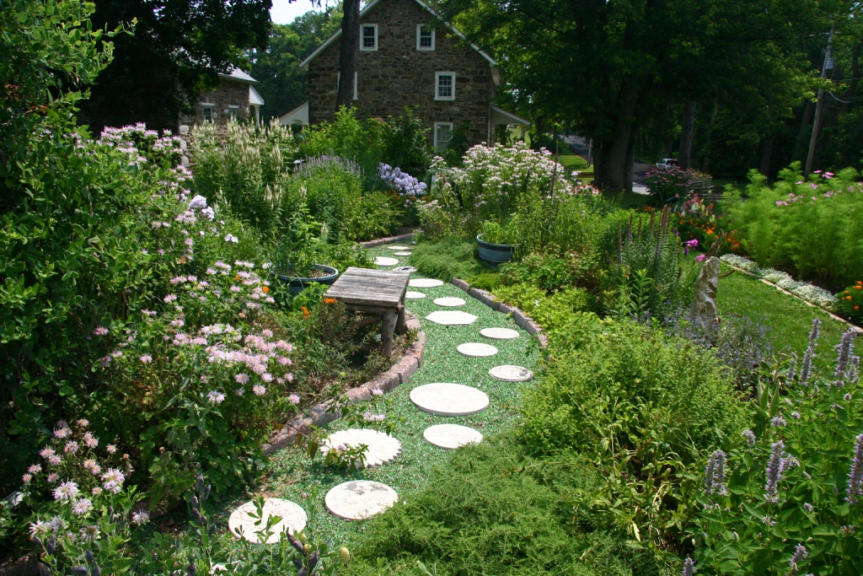
Why Pollinator Gardens?
  Public exposure
  Creating habitat in urban setting
  Educational potential
  Many possibilities for citizen involvement

Slide 20
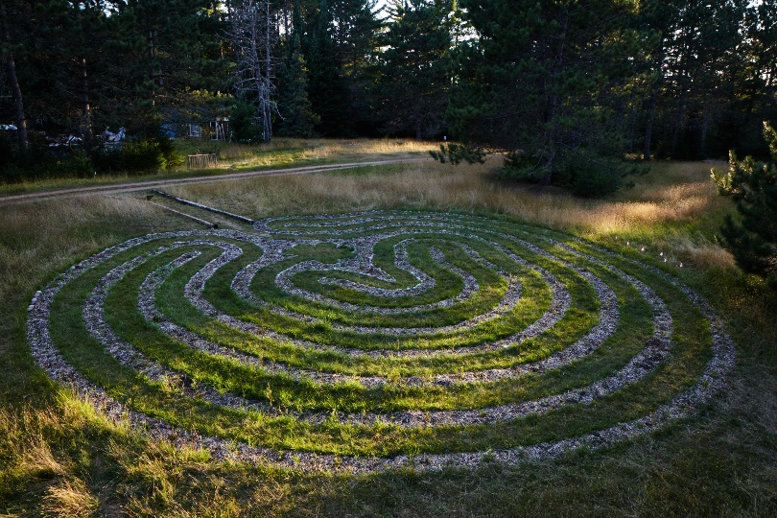
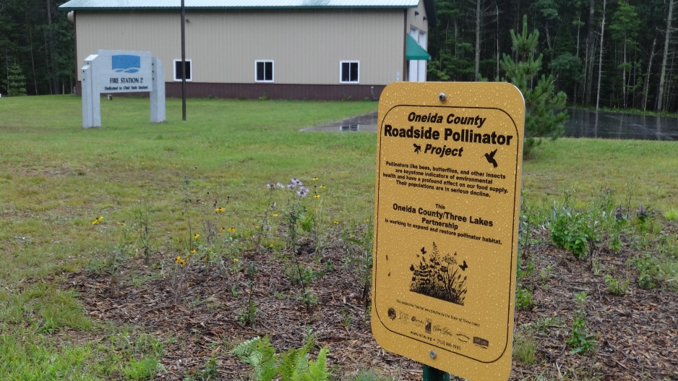
Creating new habitat
Three Lakes Fire Department 2 Town Budget (Spring 2017)
Additional Plots Three Lakes 2018 Town Budget
Healing Nature Center TL Feed a Bee (Summer 2017)
Rhinelander Court House Feed a Bee(Fall 2017)
Three Lakes Historical Society Feed a Bee (Fall 2017)
Center for the Arts TL Feed a Bee (Spring 2018)

Slide 21
Connecting Communities
Building a Pollinator Community

Slide 22
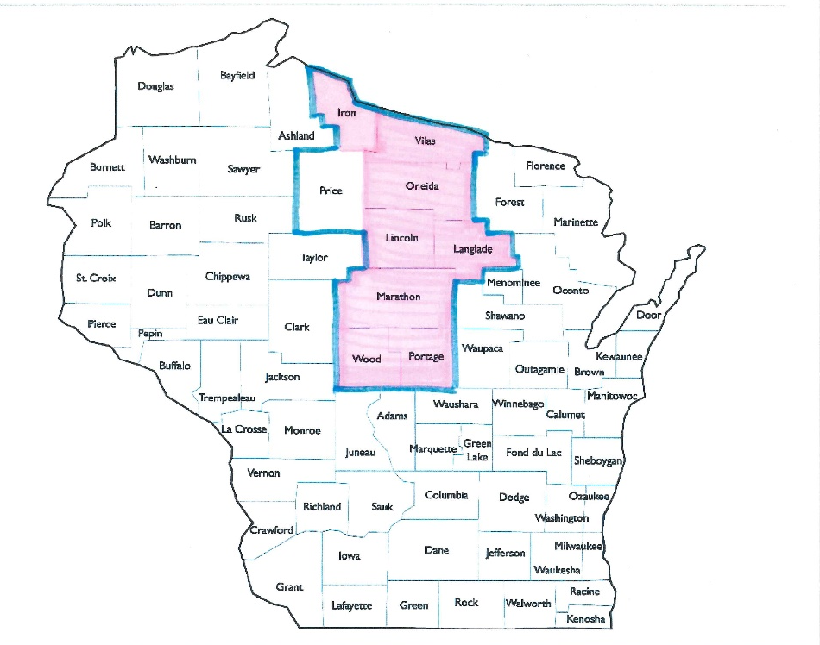
Monarch Butterfly Conservation Fund Grant – Proposed for 2018
  Regional corridor project
  Eight county partners already on board

Slide 23
  Objectives for the pollinator corridor:
  Increase native seed supply
  Restore & enhance habitat
  Create and expand new partnerships with towns and conservation agencies
  Engage citizens in pollinator protection

Slide 24
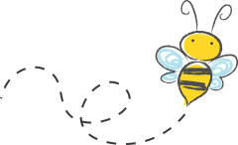
Thank You
It takes a village
☺
Oneida County
Land & Water Conservation
www.oclw.org
Baerbel Ehrig- Pollinator Coordinator

Slide 26
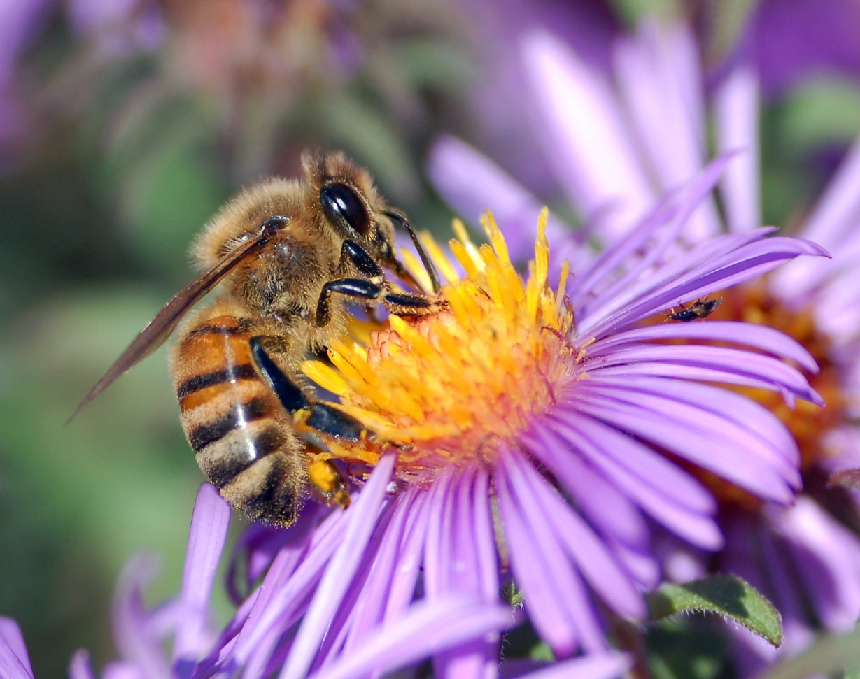
Building a Regional
Pollinator Community
(seeds are sprouting)

Slide 27
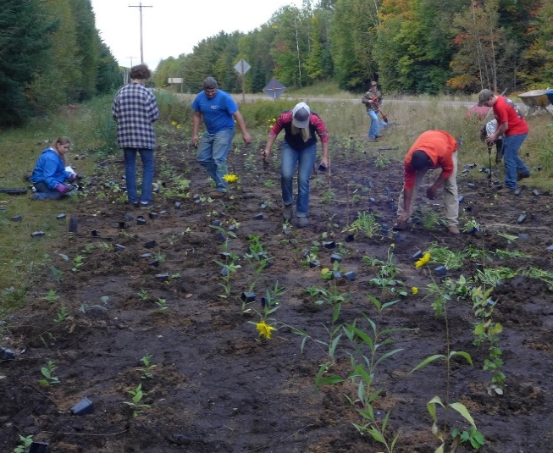
By Jennifer Hopwood, Xerces Society
By John Anderson, Hedgerow Farms, Inc
Notes:
Rattlesnake and sunflower Jennifer hopwood xerces society
Milkweed john Anderson hedgerow farms inc

Slide 28


Slide 29


    2017 and 2018 Funding:
    Town of Three Lakes Budget
Feed a Bee
    Planting forage for pollinators across U.S.

